Slide 1
White-Box Machine Learning for Cybersecurity: Extracting IOCs from Neural Networks to Characterize sqlmap Usage
Presented by Justin Whitaker
GSEC, GCIH, GCIA, GSTRT, GDSA, GCPM, GWEB, GCDA, GSOM
Master’s Degree Candidate at the SANS Technology Institute
Notes:
FIRST – make sure to review, and use all the recommended guidance and examples provided in the reference material for this course (i.e., right amount of text on the sides, use of various types of visuals, full and complete speaker notes, etc.)
Your goals for this slide and speaker notes:
Introduce your topic
Establish your identity and credentials
Begin to hook the audience into your presentation. The best presentations and learning usually include story telling. Consider incorporating a short story (not a hypothetical scenario, if possible), right here upfront on your title slide, which sets the stage for your objectives. How and why did you get interested in this topic / problem? Was there some notable workplace event that made this topic important to you? Why will this presentation be both interesting and useful to the audience?

Slide 2
Objectives
Focus on what the audience will be able to do after your presentation
After this presentation, you will:
Understand why this topic and problem are relevant to you and your organization
Know how to implement the tool or solution that is described here today
AVOID simply outlining what you will cover during the presentation
Notes:
Beginning with this slide, recognize that a stellar presentation isn’t about the topic, and it isn’t about you, the presenter. It’s about the audience, insofar as how you present the topic to them, the audience, as the real focus of this entire presentation and by giving them something that they can take away and use. From this point forward, frame every slide and speaker note to the maximum extent possible in terms of why it is interesting TO THE AUDIENCE, or how it is useful TO THE AUDIENCE. This may even include tailoring the presentation of your research to the broader SANS audience in the event that your paper was intended for some narrower, more specialized industry or audience.
Your goals for this slide and speaker notes:
Introduce your objectives as things that will be interesting and useful to the audience
Especially introduce the “nugget,” that is, what one main thing will the audience take away from this presentation that will be especially and immediately useful to them?

Slide 3
Describe Your Problem
Problem statement
Impact of the problem
Relate the problem to your audience
Notes:
Provide a problem statement. What is it that you set out to fix, or improve?
Discuss the impact of the problem. Be sure to include a sense of the impact the problem is having, or could have if left unaddressed.
Relate the problem to your audience. Make the explanation of your problem relatable to your audience…how do they share an interest or a stake in your problem, even if they perhaps didn’t know it?

Slide 4
Describe Relevant Context
As needed
Relevance
Know your audience
Notes:
As needed: Only what is required to ensure an understanding of the problem. Less is more. This is not simply an informative presentation, it is a persuasive presentation where you intend to convince the audience to use your solution/tool.
Relevance: Focus on key context which is necessary to understanding the problem, especially as led to the formulation of your methodology and experiment.
Know your audience: Don’t focus on the basics, assume your audience is a peer group of experts.

Slide 5
Describe Your Research Methodology
Research design
Focus on high-level
Goal is to demonstrate that your method was sound
Notes:
Research design: This is how you decided upon your approach to the problem, and how you designed your experiment.
Focus: Keep this high-level…your audience mostly won’t be graduate students, and thus won’t care a lot about the finer points of qualitative vs. quantitative methodology.
Language: If referring to your research sources, just call it research…not “scholarly research” (same reasoning as above)
Goal: Your aim on this slide is simply to demonstrate to the audience that your method was sound, and to allow to them replicate it if desired.

Slide 6
Describe Your Experiment
Details of how you executed your research design
Notes:
This is an extension, but more detailed and practical, of your research methodology, especially if you set up some tool or combination of tools to test in, say, a VM environment.
For qualitative experiments (e.g., surveys) describe your survey process and audience. Consider a visual, especially perhaps a flowchart.
Use visuals here whenever it can work, and then speak to the graphic.
This could expand to two slides, but no more than that!
Look to insert a story here about a notable moment, an “Ah ha!” moment, during the conduct of your experiment

Slide 7
Describe Your Experiment
Slide 2, only if needed
Notes:
Possible second slide on this, if needed, as described previously and especially if using many or dense visuals.
Include a visual of your testing rubric, if one was used.

Slide 8
Show Your Experiment in Action
Show your raw data/results
Notes:
Especially for quantitative processes and experiments, use graphics and visuals (script, command lines, packet headers or data, GUI, netword diagram, etc.) to allow your audience too “see” the interaction of your tools, process, environment, etc.
For qualitative processes, use some of the most impactful quotes or anecdotes, in advance of showing the full results, to demonstrate either (or both) powerful or unexpected results.
May extend to include three slides, if necessary.

Slide 9
Show Your Experiment in Action
Second slide, if necessary

Slide 10
Show Your Experiment in Action
Third slide, if necessary

Slide 11
Analyze/Compare Your Results
Take your results from the previous slide(s) and demonstrate the comparative strengths & weaknesses of various outcomes
Notes:
These should largely line up with your objectives, so refer back to those to ensure an aligned sequencing.
Build from small to big, if multiple types or levels of results are relevant.
If testing various different processes or tools, build from least successful to most successful.
Include a second slide, if needed.

Slide 12
Analyze/Compare Your Results
Second slide, if necessary
Include a visual of your filled out testing rubric, if one was used

Slide 13
Summary
Summarize problem, and how the results addressed it
Do not recap research method, setup of experiment, or background context
If relevant, address how further experiment on this problem might be required
Remind audience of the nugget that you’ve just handed to them
Notes:
This is your chance to leave a lasting impact on your audience, as you promised them upfront on the Objectives slide. Don’t miss this opportunity!
Include your contact information.

Slide 14
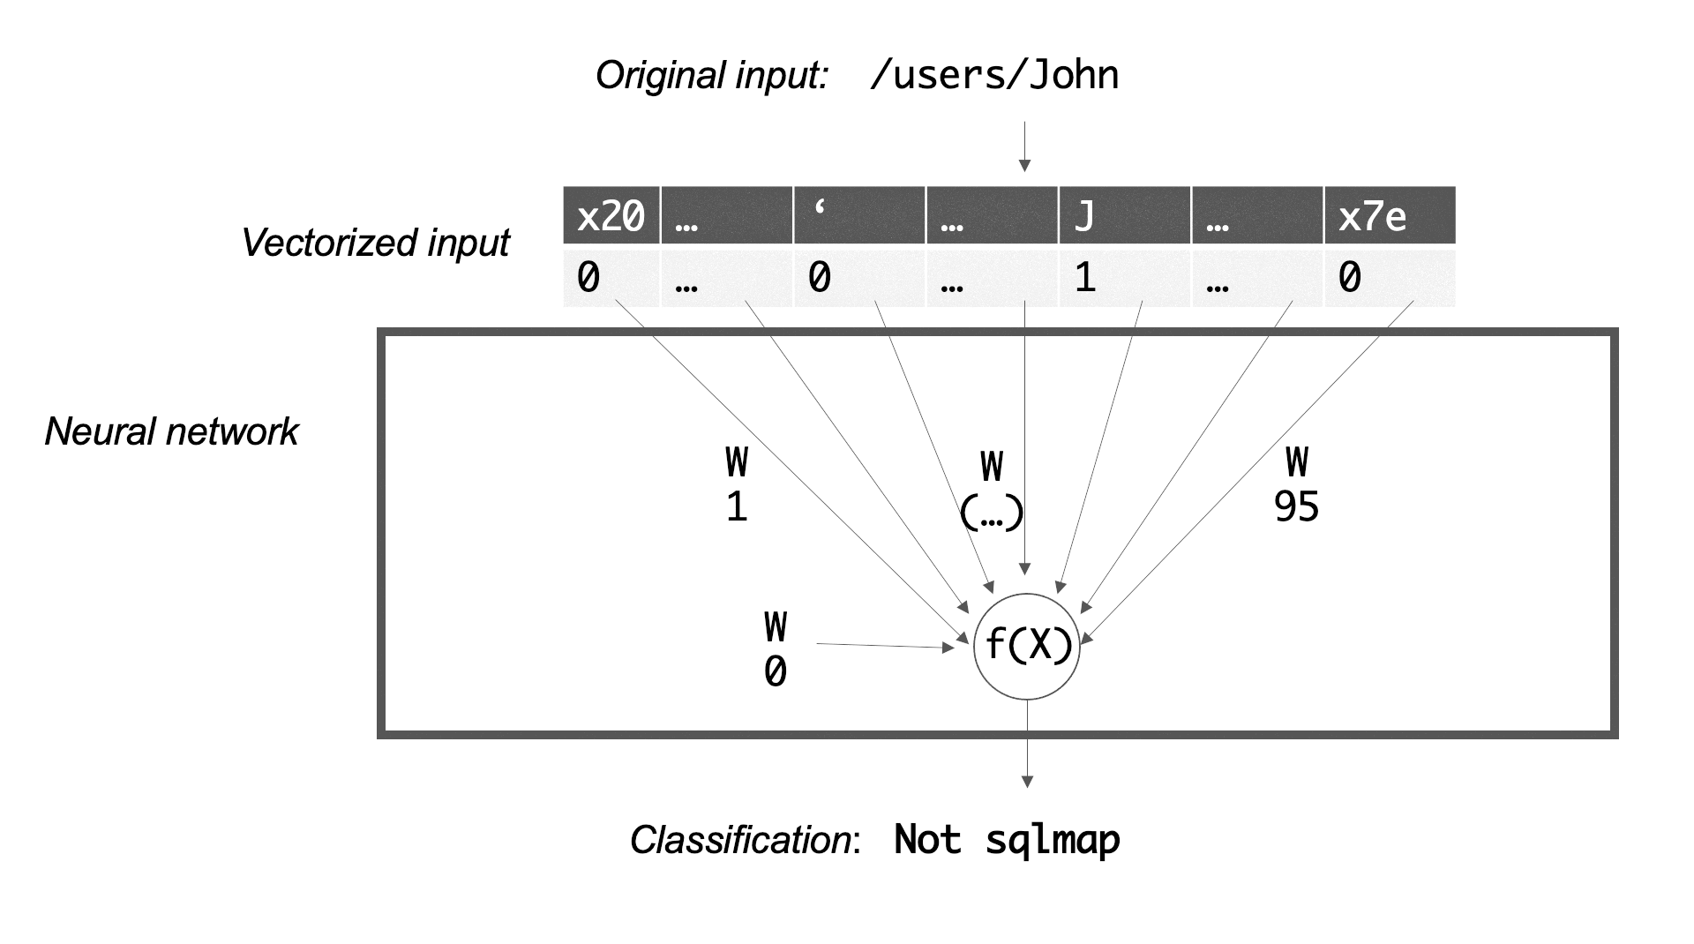
Classifier Architecture: Perceptron

Slide 15
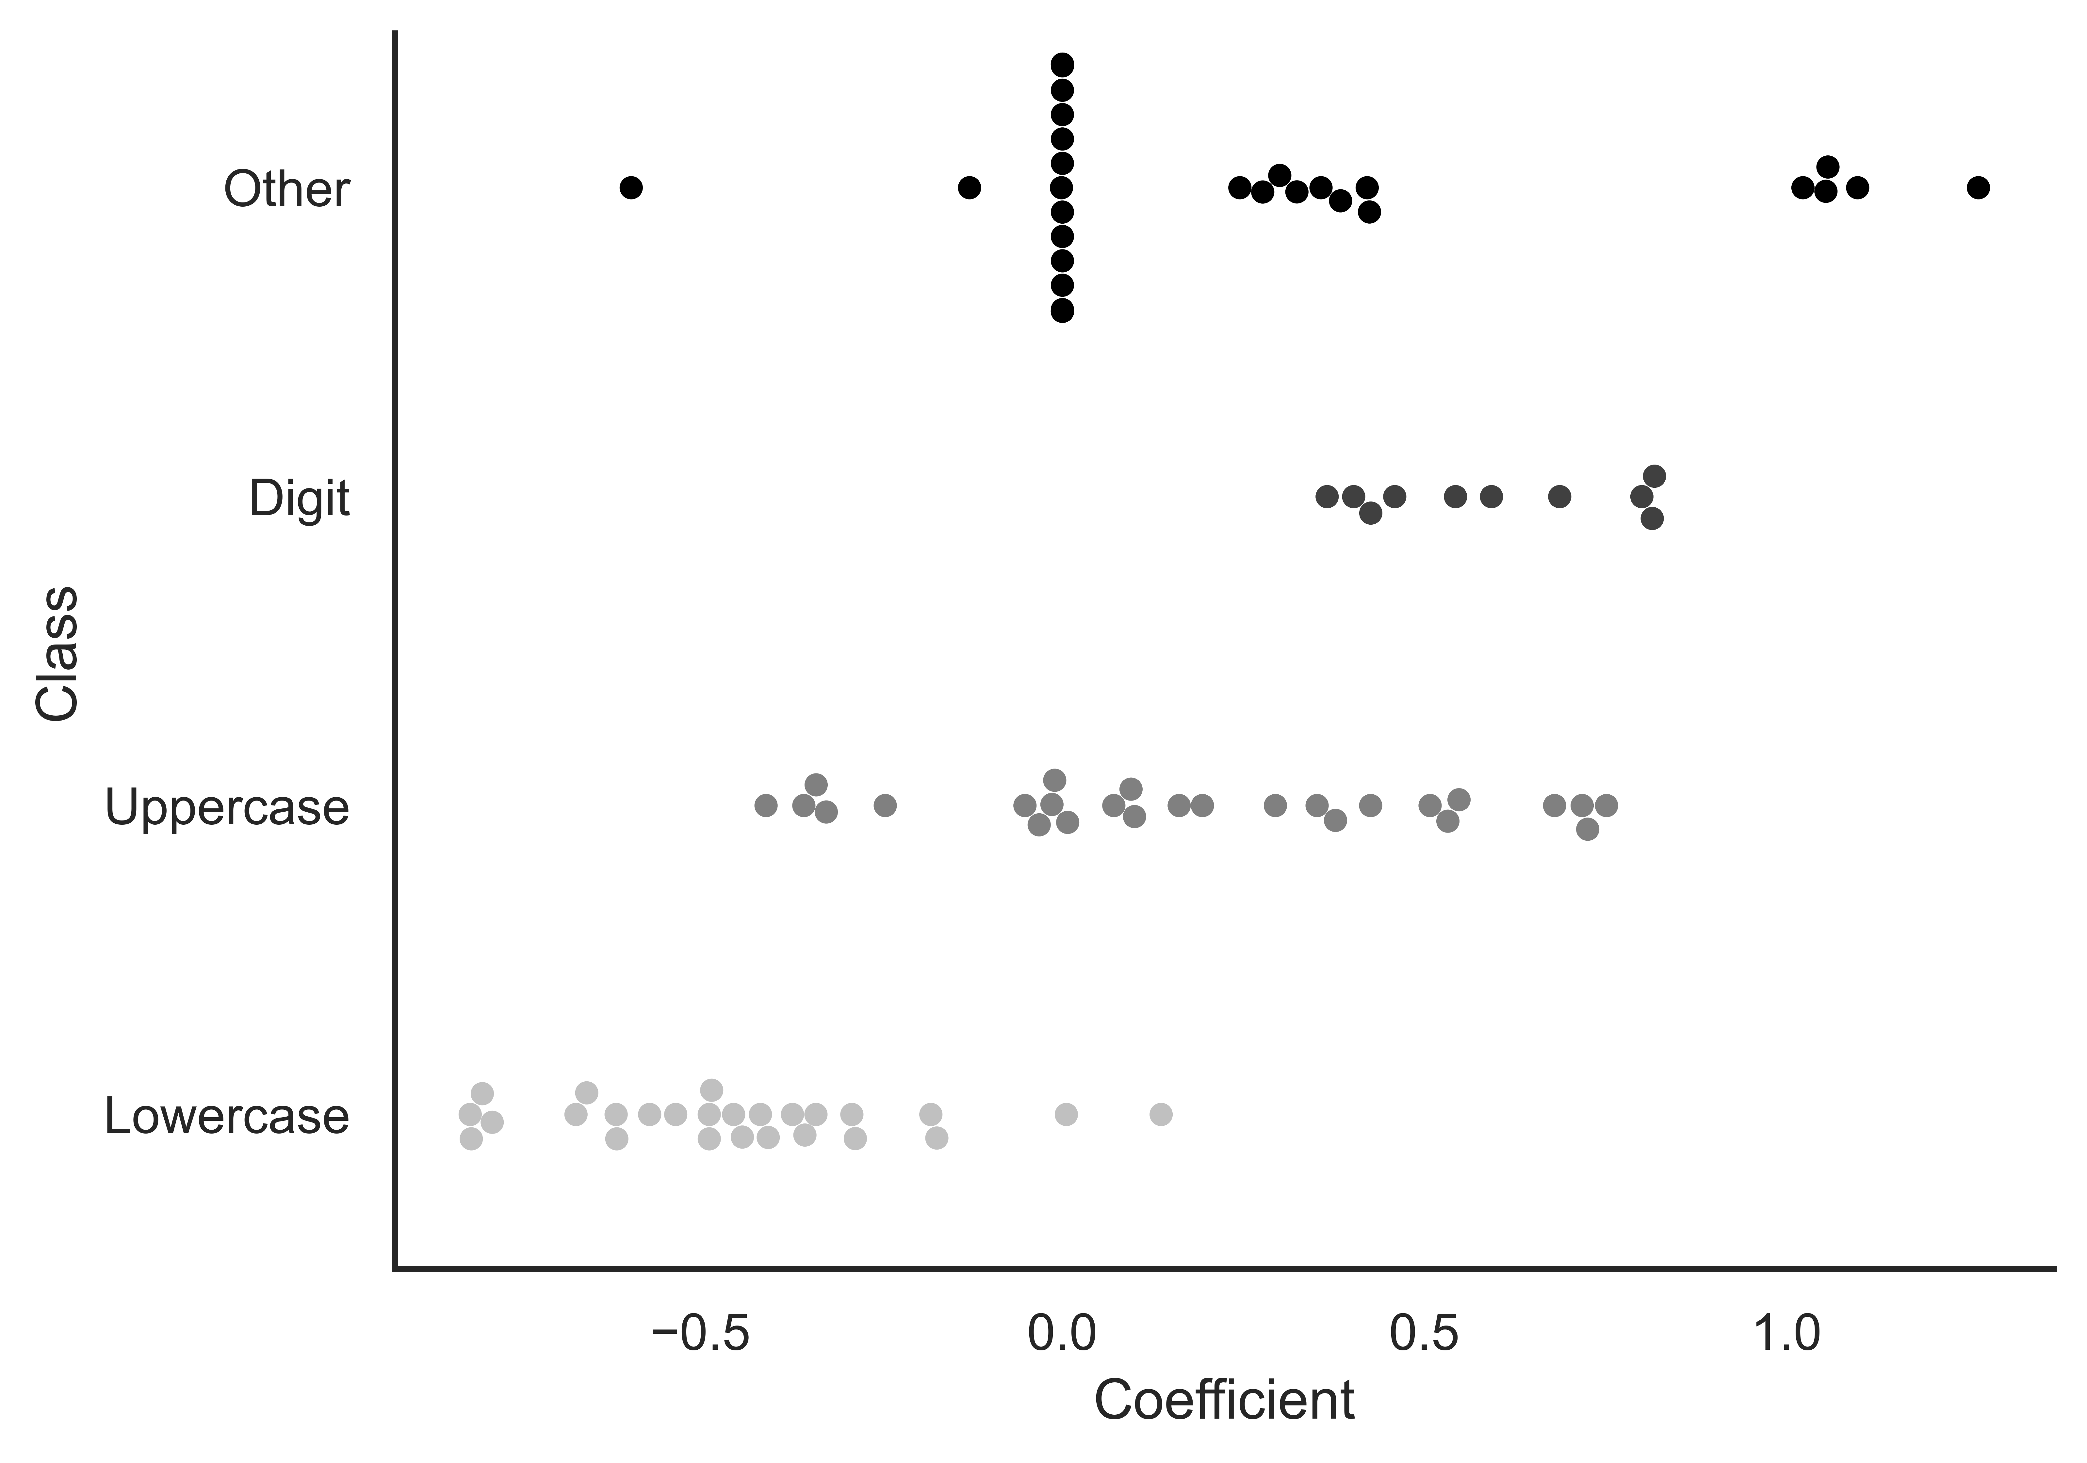
Perceptron Internals (1/2)

Slide 16
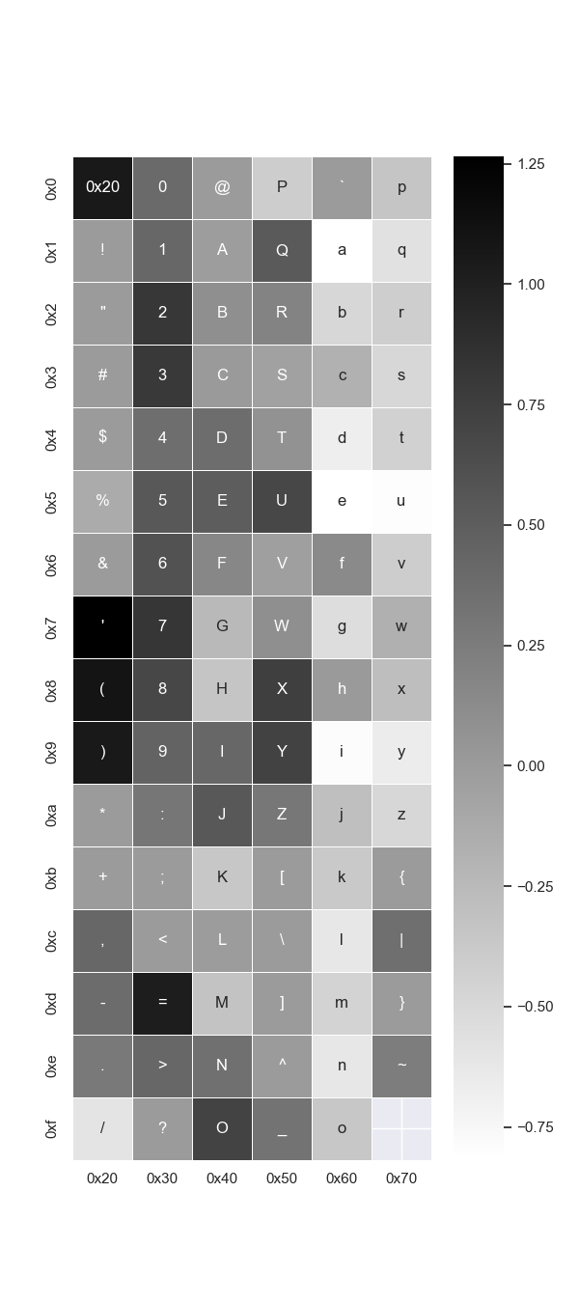
Perceptron Internals (2/2)

Slide 17
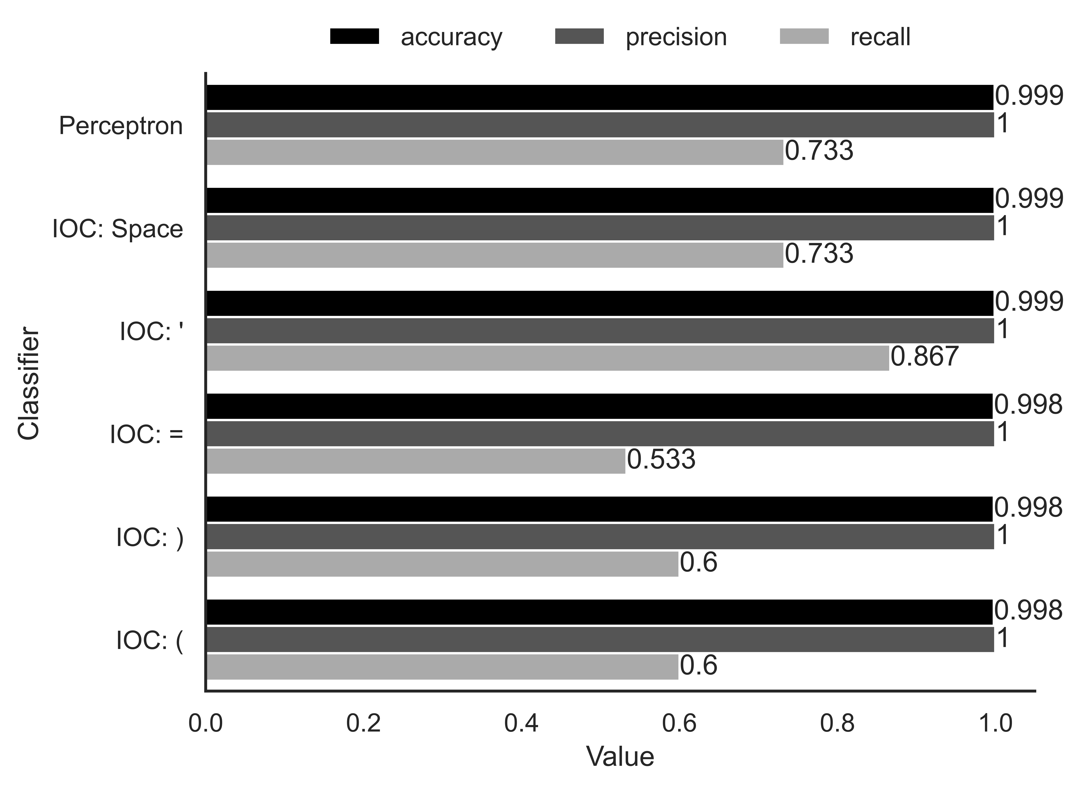
Performance: Perceptron vs IOCs

Slide 18
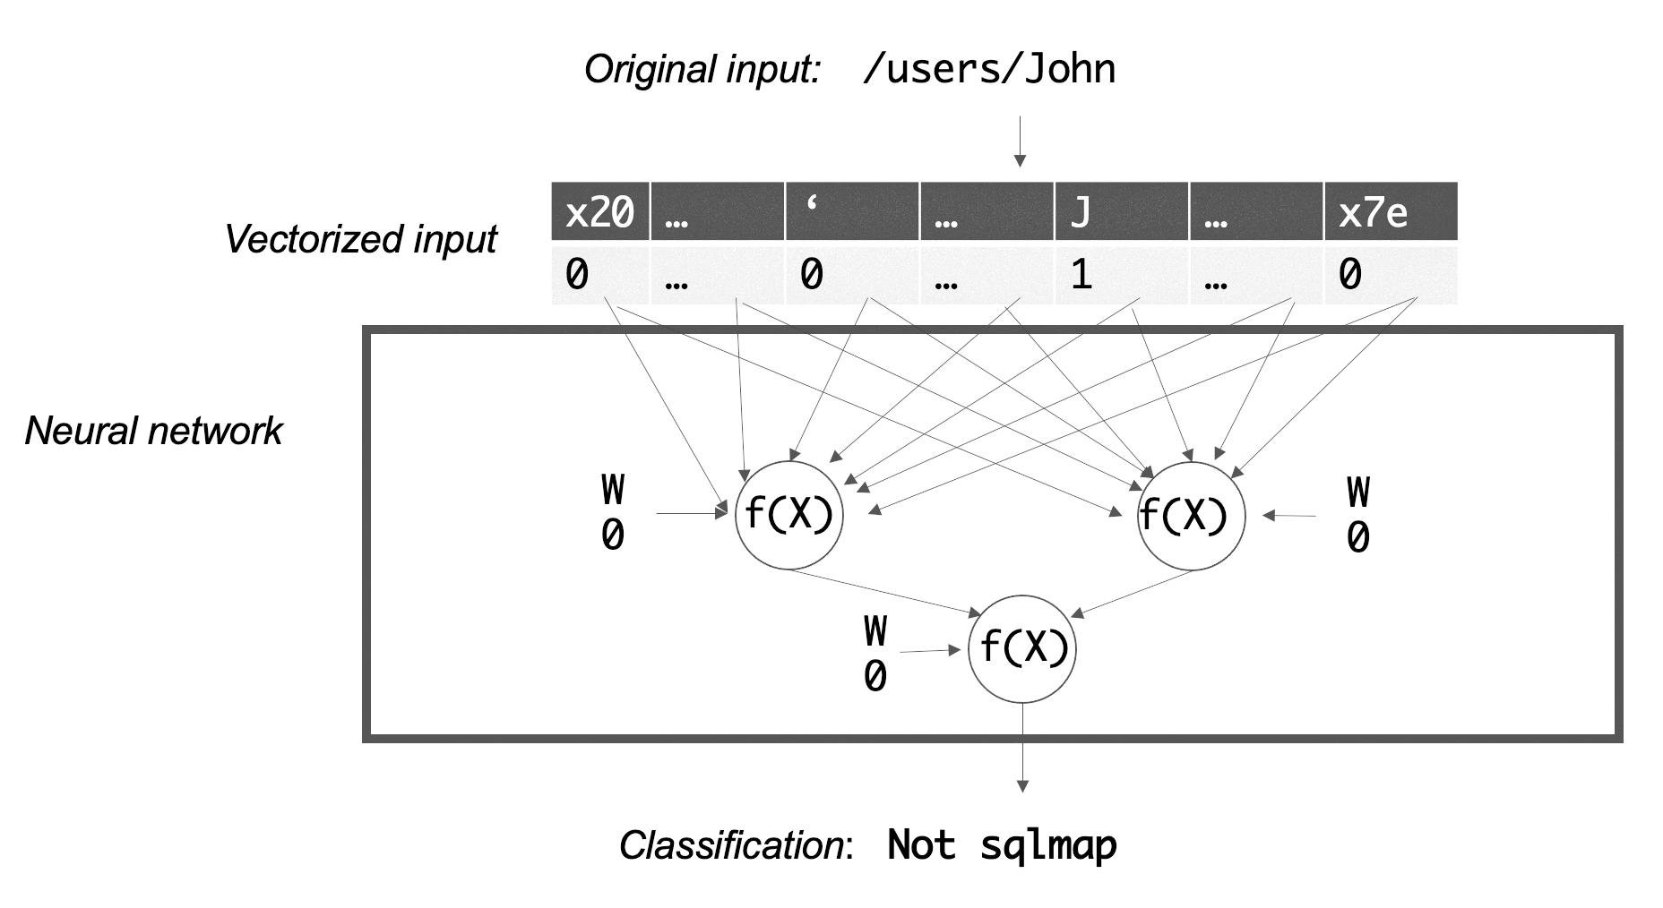
Classifier Architecture: Neural Network

Slide 19
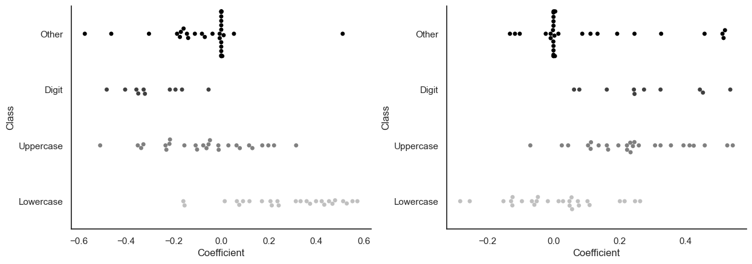
Neural Network Internals (1/2)

Slide 20
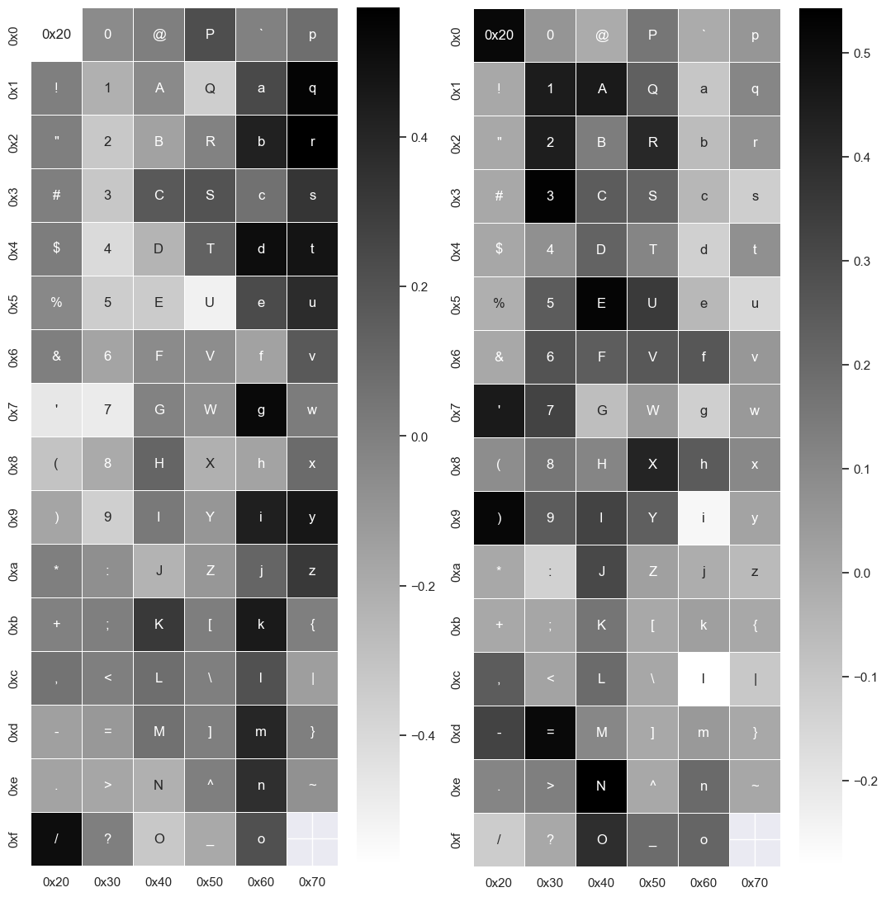
Neural Network Internals (2/2)

Slide 21
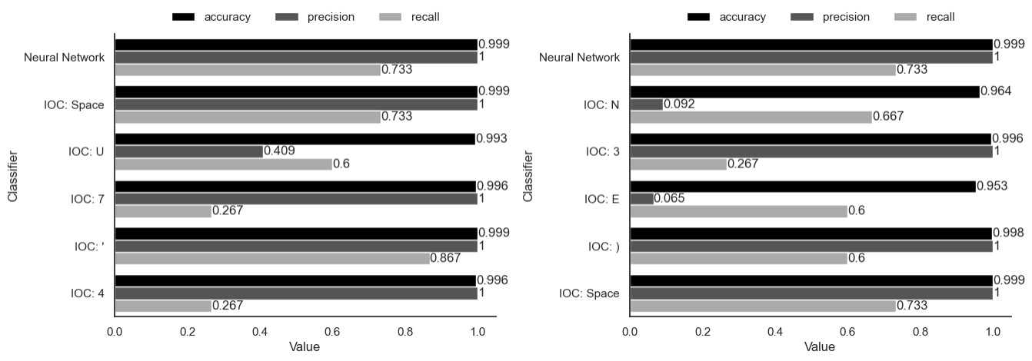
Performance: Neural Network vs IOCs

Slide 22
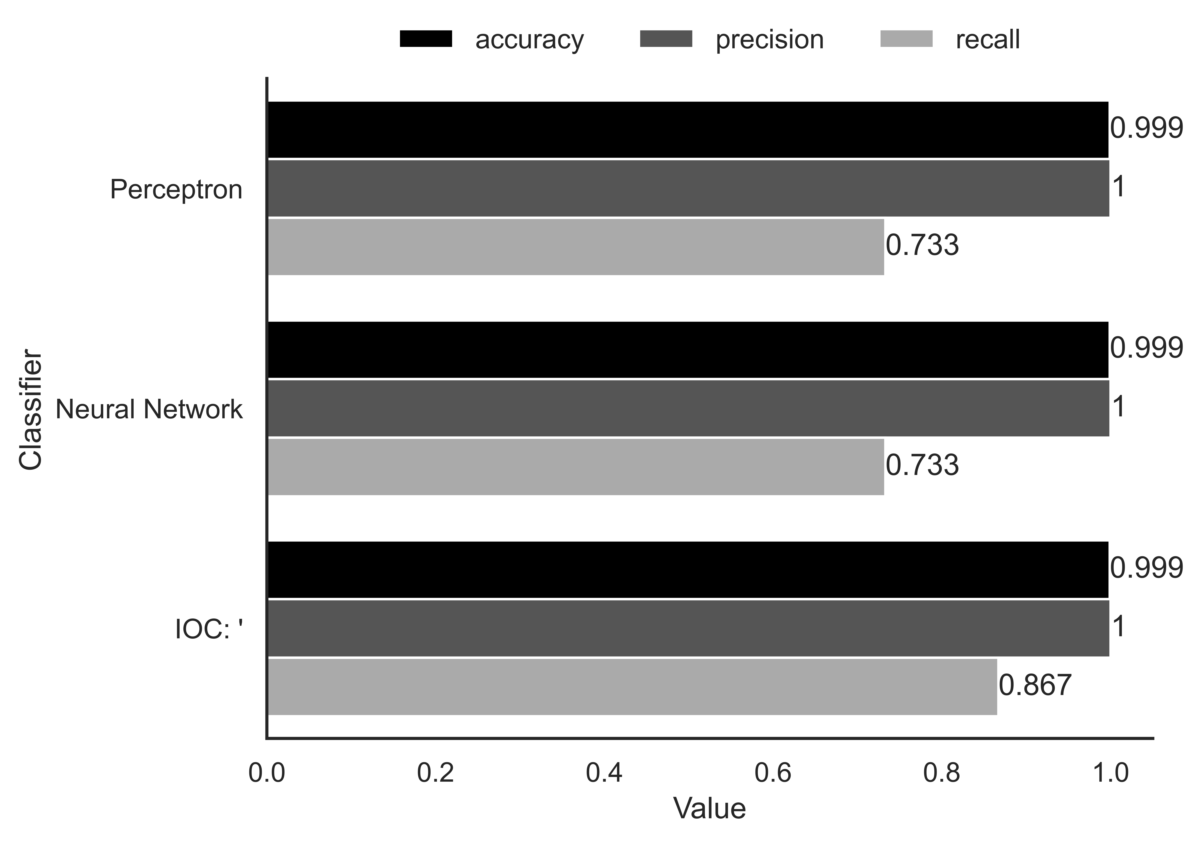
Combined Performance Comparison

Slide 23
Robustness Against Evasion
Attack
Evasion
/query/-4441' UNION ALL SELECT CHAR(113,112,122,113,113)||(SELECT (CASE WHEN (RANDOMBLOB(-1)>0) THEN 1 ELSE 0 END))||CHAR(113,122,122,106,113)
/query/-4441' UNION ALL SELECT CHAR(113,112,122,113,113)||(SELECT (CASE WHEN (RANDOMBLOB(-1)>0) THEN 1 ELSE 0 END))||CHAR(113,122,122,106,113)--abcdefghijklmnopqrstuvwxyz
Classifier | Detected Attack? | Detected Evasion?
Perceptron | Yes | No
Neural Network | Yes | Yes
Top IOC: ‘ | Yes | Yes

